Slide 1
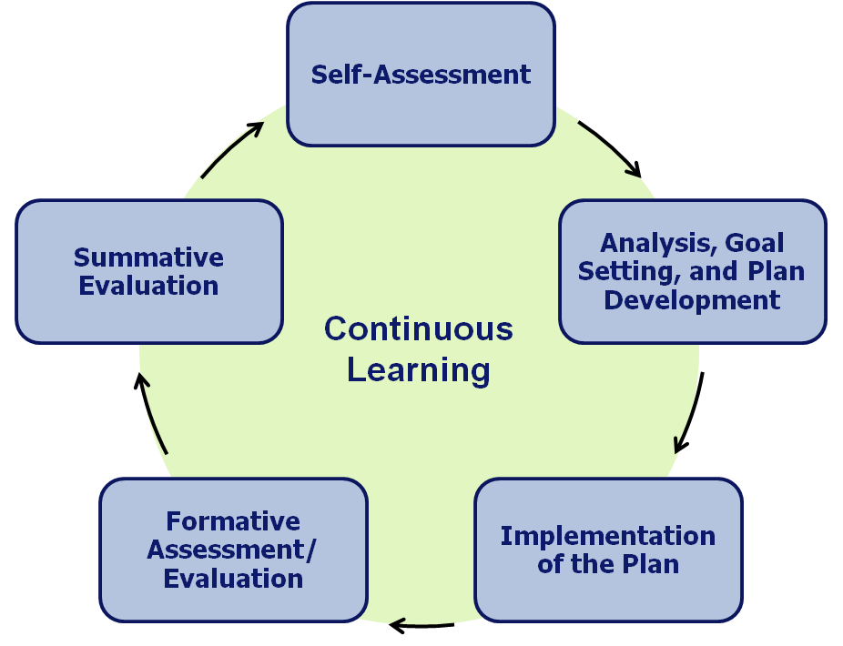
Every educator is an active participant in the evaluation process.
Every educator conducts an analysis of evidence of student learning, growth, and achievement.
Every educator conducts an assessment of practice against Performance Standards.
Every educator prepares to strategically identify professional practice and student learning goals.
Collaboration and continuous learning are the focus.
Notes:
1

Slide 2
S.M.A.R.T. Goals
S = Specific and Strategic
M = Measurable
A = Action Oriented
R = Rigorous, Realistic, and Results Focused (the 3 Rs)
T = Timed and Tracked

Slide 3
Making a S.M.A.R.T. Goal S.M.A.R.T.er
S.M.A.R.T. Goal Statement
+
Key Action Steps
+
Benchmarks (Process and Outcome)

Slide 4
Teacher Educator Plan Example
Sample Professional Practice Goal for a Teacher: During the 2012-13 school year, I will learn about a flipped classroom, create flipped units for my class and evaluate the effectiveness of a flipped classroom.
Student Learning Goal(s) and Professional Practice Goal(s) Planned Activity
Action | Supports From School | Timeline/Benchmark or Frequency
1. November 1 – December 3, I will participate in the Accept Collaborative Flipped Classroom PD 2. By December 15, I will observe other classrooms in the building who are working with a flipped model 3. January - April I will create three flipped units for my class 4. By May 1, I will ask for feedback from students and my supervisor about their perceptions of the usefulness of the implementation of my flipped class | Registration for the Flipped Class PD, maybe a sub to watch other classes with the flipped model, and feedback from my supervisor specifically about my flipped units. | September —sign up for Accept PD. Keep a notebook during the class November – December – learn about flipped class and create first unit Visit a flipped class at Keefe and record notes Meet with flipped class teachers and share best practices - ongoing *Evidence - Notes from Accept PD, flipped unit, website with flipped units, student feedback, self-reflection log

Slide 5
Teacher Educator Plan Example
Sample Student Performance Goal for a Teacher: During the 2012-13 school year, ELL students will improve their content specific writing skills in Biology class.
Student Learning Goal(s) and Professional Practice Goal(s) Planned Activity
Action | Supports From School | Timeline/Benchmark or Frequency
1. By October 1 – establish a baseline measurement of the writing ability of ELL students 2. October - January, assign daily writing assignments that vary in length 3. Observe 3 ELL classes and note best practices 4. February – assign a 3 page Biology specific writing task 5. March – conduct a formative assessment of writing ability | A sub to cover my class when I observe other classes; I might ask for PD about teaching ELL students or writing in the content area. | 1. Assign writing tasks with varying degrees of length and skill to measure growth 2. Take notes on best practices when observing classes and implement them into my class 3. Progress monitor students and provide interventions as needed 4. Assess the level and degree to which the writing level of ELL students has increased *Evidence - Keep a folder for 3 ELL students, one beginner, intermediate and higher, and collect samples of their writing throughout the year. Keep notes on class observations.

Slide 6
Implementation Responsibility
Educator Responsibilities:
Identifying, collecting & organizing artifacts/evidence related to goal progress.
Documenting action steps completed.
Collecting and submitting artifacts.
Collecting and submitting evidence related to Standards III and IV.
Evaluator Responsibilities:
Making resources and supports available.
Observing practice and providing regular and specific feedback on performance.
Monitoring progress – including midpoint check-ins.

