Slide 1
Keystone Data Presentation

Slide 2
Algebra I Data

Slide 3
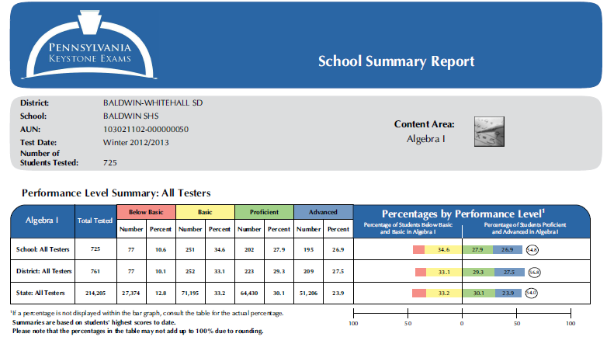
Algebra 1 Winter 2012/13
54.8%

Slide 4
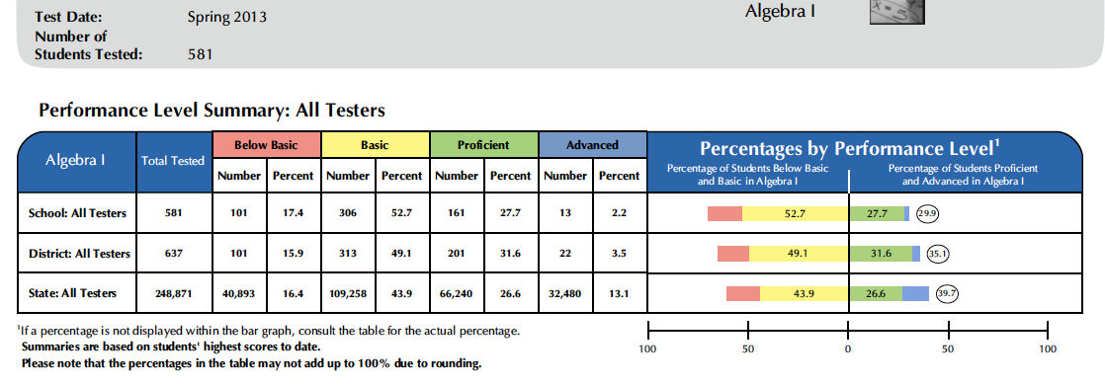
Algebra 1 Spring 2013
29.9%

Slide 5
34.5%
26.3%

Slide 6
Biology Data

Slide 7
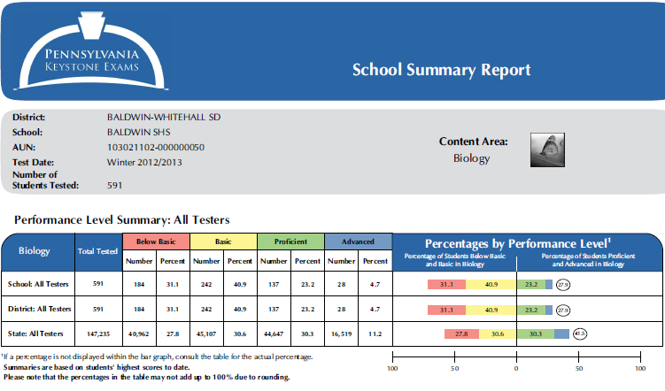
Biology Winter 2012/13
27.9%

Slide 8
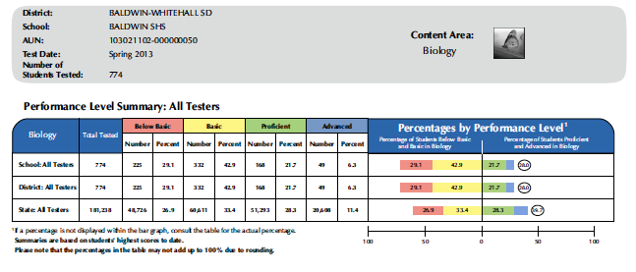
Biology Spring 2013
28.0%

Slide 9
43.2%
15.2%

Slide 10
Literature Data

Slide 11
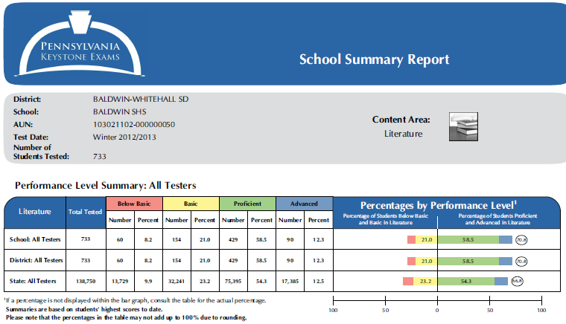
Literature Winter 2012/13
70.8%

Slide 12
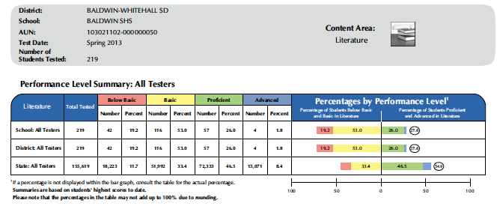
Literature Spring 2013
27.8%

Slide 13
41.7%
27.1%

Slide 14
2012-13 Keystones Grade 11

Slide 15
2012-13 Keystones Grade 10

Slide 16
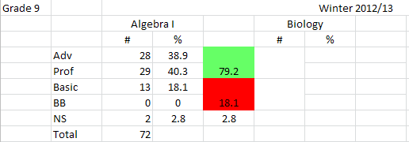
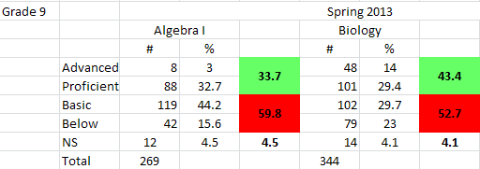
2012-13 Keystones Grade 9

Slide 17
The Road Ahead-Next Steps

